Slide 1


Menu Navigation
Project’s MID presentation
Presented by: Tzahi Ezra
Advisors:
Moshe Porian
Netanel Yamin
One semester project
Project initiation: NOV 2014

Slide 2
Contents
Remainder
Project goal
Conceptual description
Requirements
Top architecture
Background
Micro architecture
Project’s schedule

Slide 3
Remainder
In the preceding project, the following was implemented:
Generating symbols on display screen using:
GUI platform - coded with Matlab
Cyclone II FPGA
Host communication via UART protocol
Internal communication via Wishbone protocol
Input - Grayscale symbols 32 x 32 pixels
saved in external SDRAM
Output - Grayscale image resolution of 800x600 pixels
Main clock freq. 100MHz
VESA (monitor) freq. 40 Hz
Notes:
תזכורת:
משתמשים בתשתית של פרויקט קודם.
התקשורת החיצונית בין המערכת למחשב תבוצע באמצעות פרוטוקול UART
התקשורת בין הבלוקים הפנימיים תבוצע בהתאם לפרוטוקול WISHBONE
כל הבלוקים עובדים בתדר של 100 MHz למעט הVesa

Slide 4
Project’s goal
Navigation in a menu
Implement blocks in FPGA, coded in Vhdl HDL, for the following functions:
Displaying the cursor by inverting the pixels of a symbol located in the frame .
Moving a cursor right, left, up, down the from its current position.
Navigation in the menu would be performed using HW only, via buttons on the DE2 board.
In the design, special registers hold the desired cursor position, and synchronization with the GUI is supported, for debug purposes.
All the blocks would communicate via Wishbone protocol

Slide 5
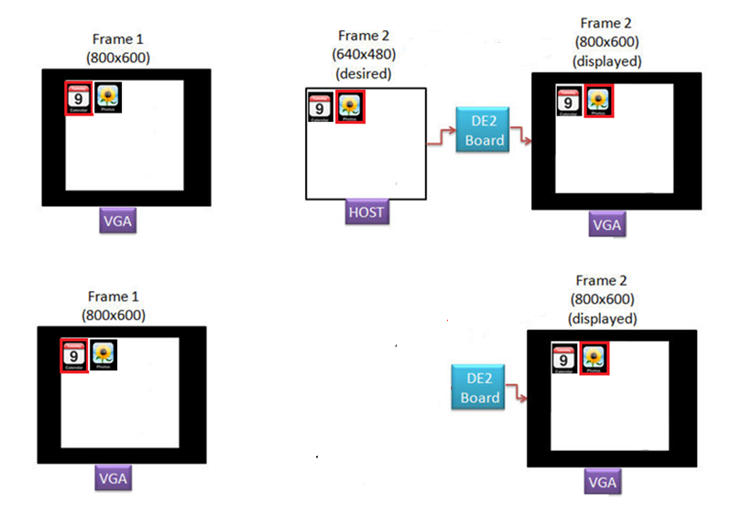
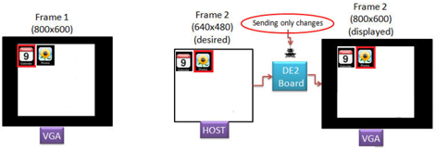

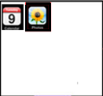
Conceptual description
Symbol insertion/removal & navigation concept
Figure 1.1 –Symbol insertion/removal using the GUI
Figure 1.2 – Menu navigation using the buttons on the DE2 board

Slide 6
Requirements
Architecture implementation
RTL coding (VHDL)
Simulation (Modelsim)
Synthesis (Quartus)
Place & Route
FPGA implementation

Slide 7
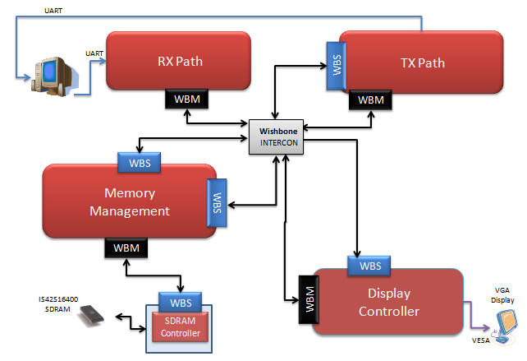

Top architecture
opcode
Navigator
Figure 2 – top architecture

Slide 8
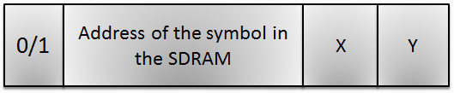
Background
6.1 Opcode Structure
SDRAM ROW(11), SDRAM BANK(2)
13 bits
Add/Remove a symbol
1 bit
Horizontal Screen Location
(0-19)5 bit
Orthogonal Screen Location
(0-14)4 bit
Figure 3 – Opcode structure

Slide 9
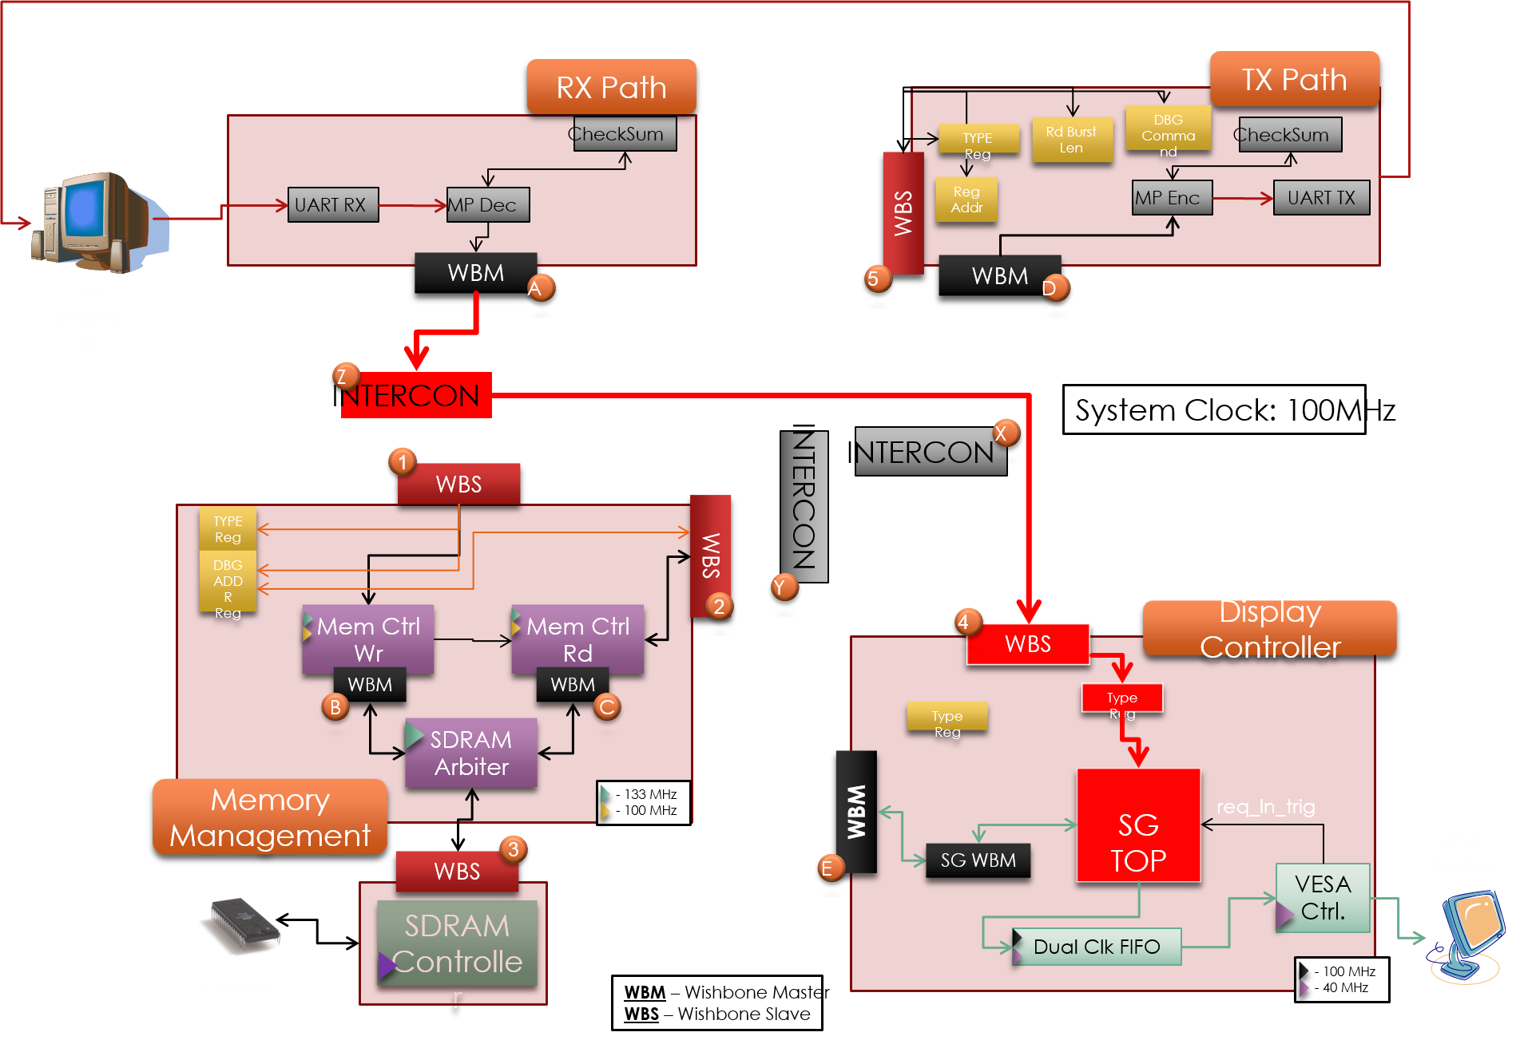
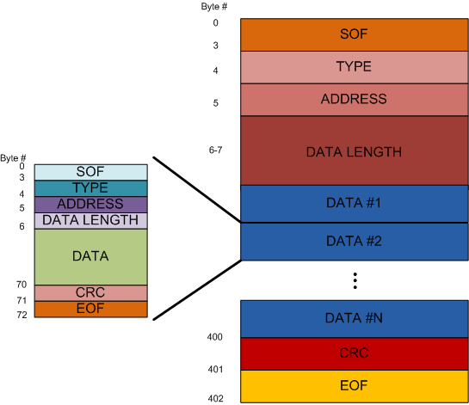

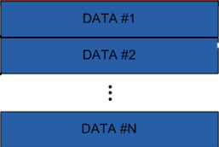
6.2.1 Continuous use:
Notes:
1.המשתמש בוחר את הסימבולים שרוצה להוסיף/להסיר או לבחור בסימבול מסוים ומוסר מידע על מיקומם,
בעזרת פלטפורמת הGUI.
2.המחשב המארח מעביר הודעה שמורכבת מפקטות של מידע על מיקום הסימבול בזיכרון הSDRAM, מיקומו על המסך, והאם הוסף/נגרע/נבחר, אל מסלול הRX. הפקטה לא עוברת בשלמותה אל ה- SG TOP, היא מגיעה ל- RX PATH וזה מקלף לה את header , שומר ערכים כמו length ו- type ברגיסטרים שלו ומעביר את המידע (ה- Payload) לפי ה-type אל עבר היחידה המתאימה.
לאחר מכן המידע עובר אל הRam ומרגע הגעת סיגנל VSYNC (המורה על התחלת הצגת הframe מהפינה השמאלית העליונה), המידע על השינויים מהframe הקודם נשמרים בו. בלוק הManager שבתוך הSG TOP נשלחת בקשת קריאה מהSDRAM, ומשם המידע יועבר אל הVESA Controller Block, בעזרת שימוש בdual clk FIFO, ומשם המידע יעבור אל תצוגת הVGA.
3. סעיף מס' 2 יחזור על עצמו.

Slide 10
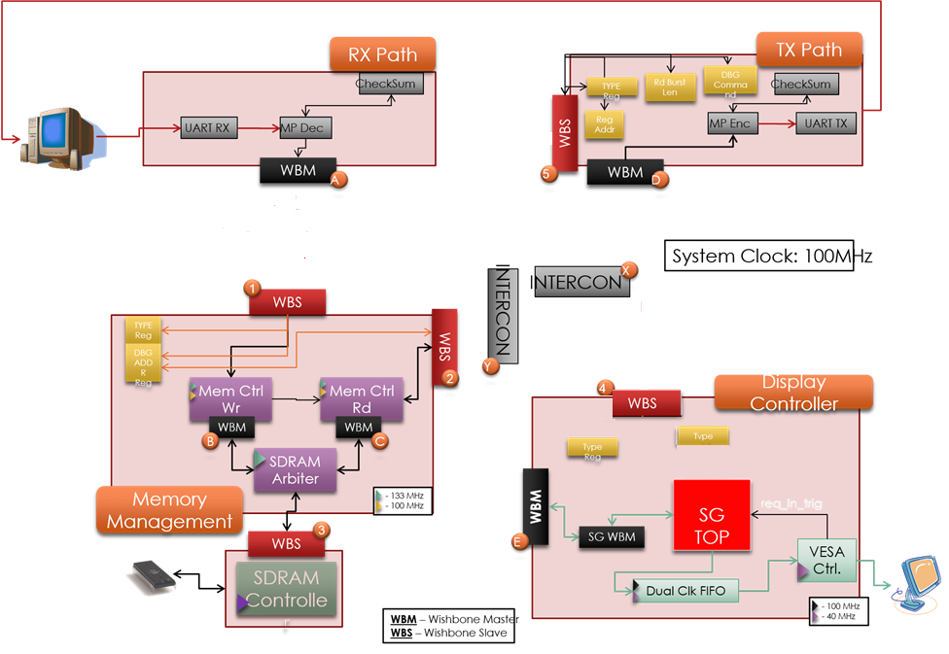
6.2.2 Continuous use:
INTERCON
Notes:
1.המשתמש לוחץ על אחד הלחצנים שנמצאים בDE2 בורד.
2.ערכי הרגיסטרים של מיקום הסמן מתעדכנים בתגובה ללחיצה.
3. מתוך ערכי הרגיסטרים, נייצר הודעה על מיקום הסמן שתגיע אל מסלול הTX דרך הWISHBONE INTERCONNECT בהתאם לשדה הtype שנגדיר אותו להיות בלוק הTX, וזה יקלף לה את header , ויעביר את המידע (ה- Payload) אל עבר התוכנה.
3. סעיף מס' 2 יחזור על עצמו.

Slide 11
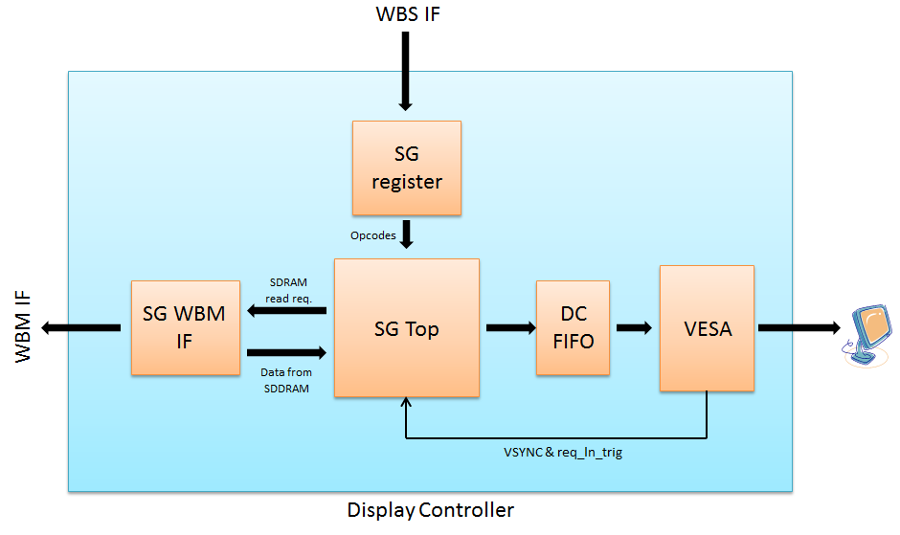
6.3 Display Controller
Display controller top diagram:
SG
Figure 6 – display controller inner implementation

Slide 12
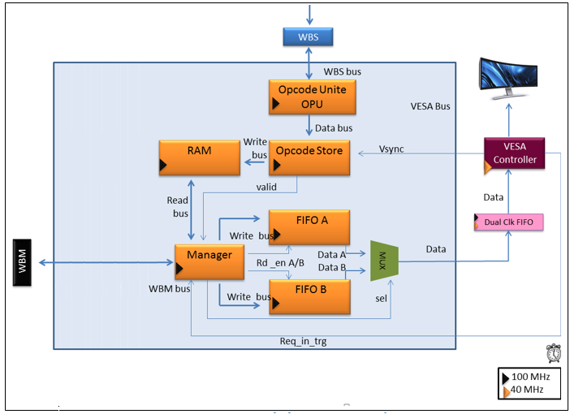
6.4 Symbol generator top
Navigator
inversion
Figure 7 – symbol generator inner implementation

Slide 13
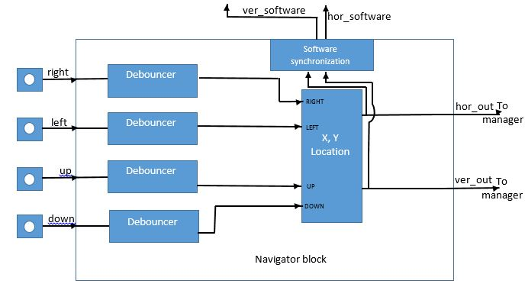
Micro architecture
7.1 Navigator block
The following diagram shows a general scheme of the navigator block and its interconnection to DE2
buttons
DE2
Figure 8 – project’s main scheme

Slide 14
7.2 x_y_location states table
down |  | up |  | left |  | right
Next state |  |  |  |  |  |  |  | Curr. state
Y | X | Y | X | Y | X | Y | X | Y | X
1 | 0 | 14 | 1 | 14 | 19 | 0 | 1 | 0 | 0
1 | 19 | 14 | 19 | 0 | 18 | 1 | 0 | 0 | 19
0 | 18 | 13 | 19 | 14 | 18 | 0 | 0 | 14 | 19
0 | 0 | 13 | 0 | 13 | 19 | 14 | 1 | 14 | 0
1 | X | 14 | X+1 | 0 | X-1 | 0 | X+1 | 0 | 1..18
19 | Y+1 | 19 | Y-1 | Y-1 | 18 | Y+1 | 0 | 1..13 | 19
0 | X-1 | 13 | X | 14 | X-1 | 14 | X+1 | 14 | 1..18
Y+1 | 0 | Y-1 | 0 | Y-1 | 19 | Y | 1 | 1..13 | 0
Y+1 | X | Y-1 | X | Y | X-1 | Y | X+1 | 1..13 | 1..18
Table 1– x_y_location states

Slide 15
7.2 DE2 buttons pressing concept
The following animation shows the process where only when the user presses a button for at least 0.5 sec (changeable), then the debouncer outputs a pulse that updates the X,Y values according to the button pressed
( , ).
0.3
0.1
0.2
0.5
0.4
DE2
debouncer
debouncer
debouncer
debouncer
Figure 5 – buttons pressing concept

Slide 16

7.5 Debouncer block
The debouncer top block diagram:
Figure 11 – debouncer top block

Slide 17
7.5.1 Debouncer block operation
The debouncer is a counter which counts how long its input is '1', and triggers when it reaches a defined value (in our case, 0.5 sec is used). It works with the system frequency (100 MHz) such that when it reaches the defined value, its output turns from '0' to '1' for 1 period, than return to '0'.

Slide 18
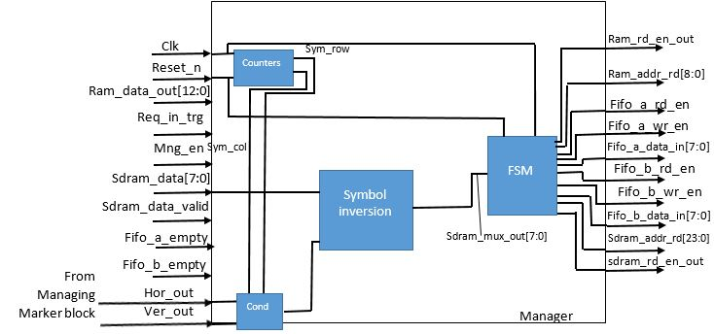
7.1.1 Manager block
The Symbol inversion unit, and Cond unit, were added to the Manager block, to enable the symbol selection by
inverting its pixels, when the internal count of sym_row (symbol row) and sym_col (symbol column), equals to
the value of Hor_out, Ver_out (horizontal and vertical symbol’s location or X,Y registers value) from the
Managing Marker block.
Symbol inversion
Cond
Figure 8.1 – new manager block with Symbol inversion and cond blocks

Slide 19
7.4 Symbol inversion block
The Symbol inversion top block diagram:
pixel(7:0)
Symbol inversion
data_out(7:0)
Cond
Figure 10– debouncer top block

Slide 20
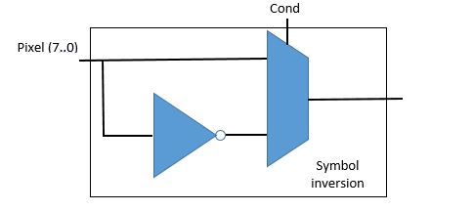
7.4.1 Symbol inversion block inner implementation
Marking of a symbol would be responded by inverting the symbol pixels (32*32).
In the manager block, the information of each pixel of the chosen symbol, being read from the SDRAM is inverted before being written to the fifos and passed to the VESA display. Using a mux as shown in the figure below, the pixel itself or its inverted version are chosen to be the data_out. The Cond would be ‘1’ if the internal row and column that are being calculated (represent the current displayed symbol) matches the desired marker symbol’s location.
data_out(7:0)
Figure 10.1 – symbol inversion block inner implementation

Slide 21
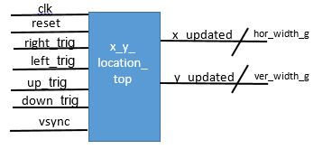
7.6 x_y_location_top block
Figure 12 –x_y_location_top block

Slide 22
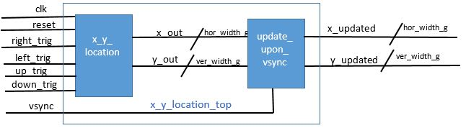
7.6.1 x_y_location_top block inner implementation
The following diagram represent the block's inner implementation.
This block consists of 2 building blocks: x_y_location block and update upon vsync block. The first is used to determine and hold the cursor location due to buttons presses, and the second is used to update the location, only upon vsync signal arrival.
Figure 12.1 – x_y_location_top inner implementation

Slide 23
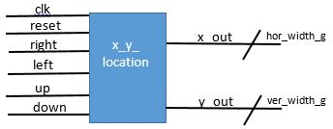
7.6 x_y_location block
The x_y_location block diagram:
Figure 12 –x_y_location block

Slide 24
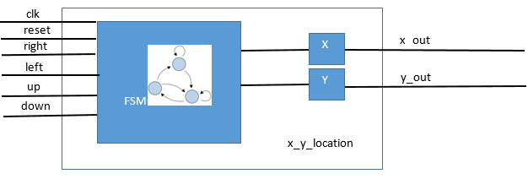
7.6.1 x_y_location block inner implementation
The following diagram represent the block's inner implementation.
This block uses an FSM to manage its operation.
Figure 12.1 – x_y_location inner implementation

Slide 25
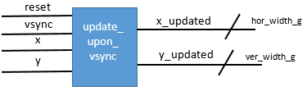
7.7 update_upon_vsync block
Figure 13 –update_upon_vsync top block

Slide 26
7.7.1 update_upon_vsync block operation
This block responsible for outputting an updated X, Y values for cursor location, only upon vsync signal arrival.
When vsync signal is triggered high, the horizontal and vertical location output would take x, y
values accordingly, when reset is triggered high x, y would be all zeros, and else the outputs
keep their previous values.

Slide 27
Project’s schedule
Date | Goals
13/11/2014 – 31/21/2014 | Project Characterization& Prior Study Conduction
31/12/2014 | Characterization Presentation
31/12/2014 – 26/1/2015 | Full Characterization of all blocks
26/1/2015 – 31/3/2015 | Exam period
31/3/2015 – 07/5/2015 | Characterization & RTL Coding (VHDL)
07/5/2015 | Mid presentation
07/5/2015 – 21/7/2015 | RTL Coding (VHDL) and simulation
21/7/2014 –21/8/2015 | Synthesis, FPGA implementation & HW debug
21/8/2015 | Final presentation

